Slide 1
DATA ANALYTICS & BUSINESS INTELLIGENCE PROJECT
Financial Fraud Analysis
Identifying Fraud Patterns, Risk Indicators, and Business Insights Using Python
Presented by Darshan | Analysis Using Python
Notes:
Good morning/afternoon. Today I'm presenting my Python-based financial fraud analysis project — one million transactions from 2020 to 2024, aimed at finding real fraud patterns and separating fraud volume from actual fraud risk.

Slide 2
FOUNDATIONS
Dataset Overview
1,000,000
26
2020–2024
Records (Transactions)
Columns / Features
Time Period Covered
VARIABLE CATEGORIES IN THE DATASET
Transaction Details
Customer Information
Fraud-Related Attributes
Date, time, hour-of-day, amount, weekend/night flags, and transaction frequency
Customer age, credit score, account age, account balance
Fraud flag, fraud type, failed login attempts, and recent PIN change
Payment & Device Info
Geographical Data
Transaction Origin
Payment method and device type used for each transaction
Country, city, and distance of transaction from customer's home
Domestic vs. international transaction status
Financial Fraud Analysis
2
Notes:
Before diving into fraud specifically, here's the dataset itself: one million transaction records with 26 columns spanning five years. The columns fall into a few natural groups — transaction details, customer information, fraud-related attributes, payment and device info, and geographic data. This breadth is what let me look at fraud from so many angles.

Slide 3
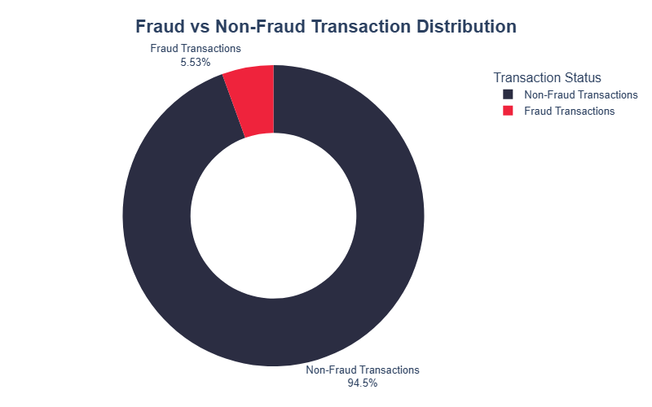
THE BASELINE
Overall Fraud Overview
1,000,000
2020–2024
55,255
Total Transactions
Time Period
Total Fraud Transactions
5.53%
198,662
48,121
Fraud Rate
Total Customers
Customers Affected by Fraud
KEY INSIGHTS
Across the full dataset, 55,255 of 1,000,000 transactions were fraudulent — an overall fraud rate of approximately 5.53%.
Among 198,662 unique customers, 48,121 (about 24%) were affected by at least one fraudulent transaction — a meaningful share of the customer base.
The overall fraud rate serves as the benchmark against which every customer segment, channel, country, and transaction characteristic is compared in this analysis.
Financial Fraud Analysis
3
Notes:
This is the baseline everything else compares against. Overall, 55,255 of one million transactions were fraudulent — 5.53%. Just as important: of about 199,000 unique customers, 48,121 — roughly a quarter — were touched by fraud at least once. I'll come back to this 5.53% benchmark throughout, since every segment I look at gets compared to it.

Slide 4
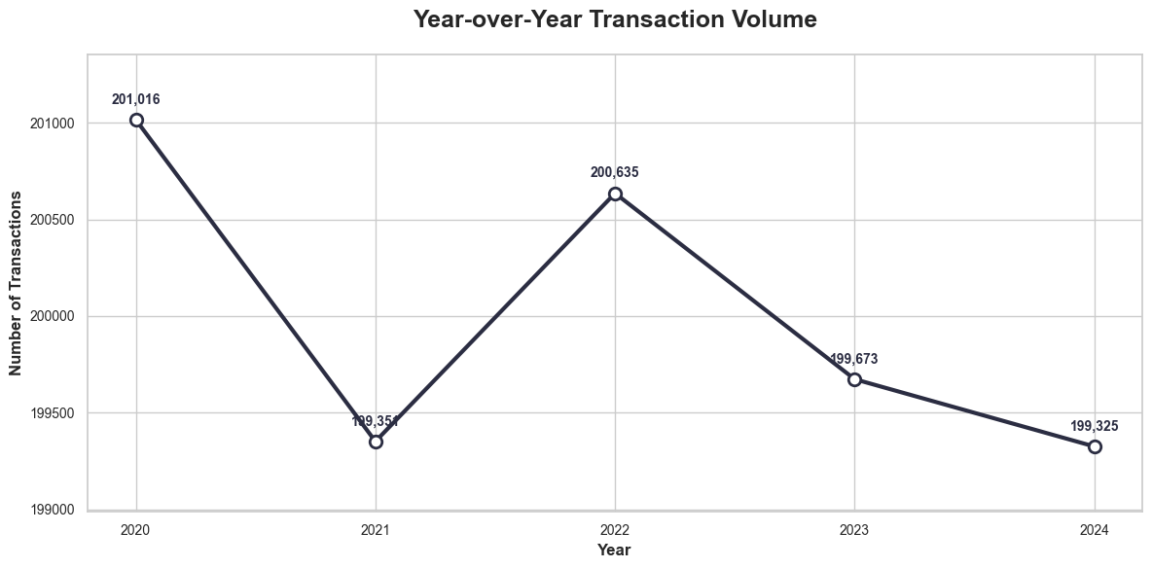
THE LONG VIEW (2020–2024)
A Persistent, Not an Escalating, Problem
KEY INSIGHTS
Annual transaction volume stayed close to 200,000 transactions every year from 2020 through 2024 — essentially flat, not growing.
Annual fraud rates were also stable, ranging from approximately 5.49% to 5.58% over the five-year period.
The stability of both transaction volume and fraud rate suggests that fraud is a persistent operational problem rather than a rapidly growing one.
NOTE
This should not be read as strong transaction growth — volume is flat, not rising.
Recommendation: Since the fraud rate has remained close to 5.5% for five years, fraud prevention should be treated as an ongoing operational priority rather than a one-time solution. The company should also analyze short-term trends and specific customer or transaction segments instead of assuming that a stable annual fraud rate means the risk is under control.
Financial Fraud Analysis
4
Notes:
This chart shows transaction volume by year — notice it hovers right around 200,000 each year, no real growth or decline. Fraud rates were just as stable, staying near 5.5% the whole time. I want to be careful here: this is NOT strong growth. The real story is that fraud is a persistent, steady operational problem — not a fire that's spreading. That changes how a company should respond: build durable controls, not a one-time crackdown.

Slide 5

LATEST YEAR BASELINE (2024)
2024 Fraud Overview
199,325
10,949
5.49%
Total Transactions
Total Fraud Transactions
Fraud Rate
126,236
10,643
94.51%
Total Customers
Customers Affected by Fraud
Non-Fraud Rate
KEY INSIGHTS
In 2024, 10,949 of 199,325 transactions were fraudulent, producing a fraud rate of 5.49%. Among 126,236 unique customers, 10,643 were affected by at least one fraudulent transaction.
Financial Fraud Analysis
5

Slide 6
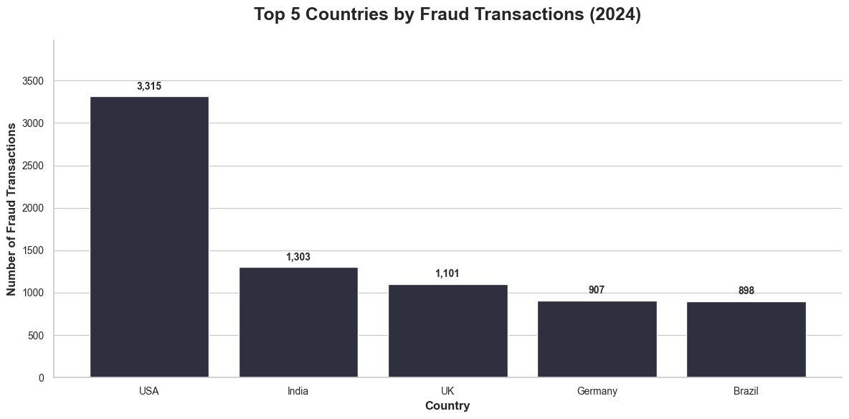
FRAUD CONCENTRATION (2024)
Country-Level Fraud Concentration
KEY INSIGHTS
The USA recorded the highest number of fraudulent transactions in 2024, with 3,315 cases, followed by India with 1,303 and the UK with 1,101.
Despite the differences in fraud counts, fraud rates across these countries were relatively similar, generally ranging from 5.1% to 5.7%.
NOTE
High fraud counts can be driven by high transaction volume, so count alone can incorrectly flag a large market as high risk.
Recommendation: Use fraud count to plan the investigation workload and fraud rate to measure relative risk. Avoid classifying the USA as the highest-risk country based only on its number of fraudulent transactions.
Financial Fraud Analysis
6
Notes:
Looking at geography: the USA has by far the largest number of fraud cases in 2024. But when I calculated fraud RATE by country, they were all fairly close, around 5 to 6 percent. So the USA isn't necessarily the riskiest country — it just has more transactions overall, so more fraud cases surface there.

Slide 7
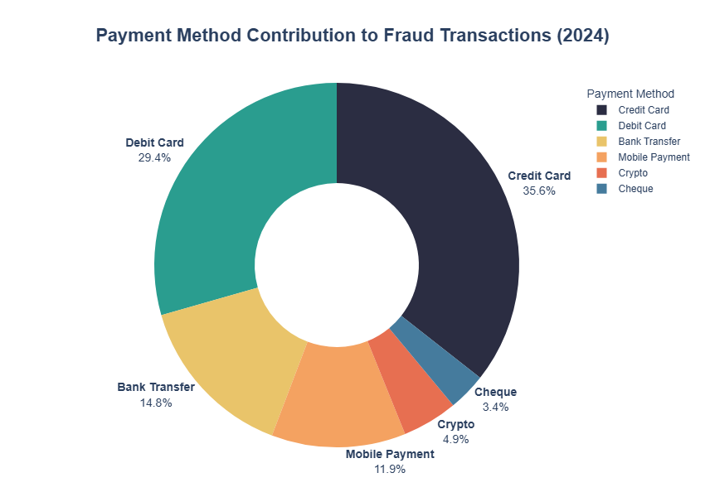
FRAUD CONCENTRATION (2024)
Payment Method Analysis
KEY INSIGHTS
Credit Cards accounted for the largest share of fraudulent transactions in 2024 at 35.6%, followed by Debit Cards at 29.4%.
However, Cheque transactions had the highest fraud rate at 6.22%, while the fraud rates for other payment methods ranged from approximately 5.4% to 5.6%.
NOTE
This chart shows fraud contribution (share of fraud cases), not fraud rate — the two tell different stories.
Total Fraud Transaction :- 10949
Recommendation: Use fraud contribution to allocate investigation resources. Credit and Debit Cards require significant monitoring because of their high transaction volume. However, use fraud rate to assess the risk of each payment method and give special attention to Cheque transactions because of their higher fraud rate.
Financial Fraud Analysis
7
Notes:
Payment method tells a similar story with a twist. Credit and Debit Cards dominate fraud volume — makes sense, they're used the most. But when I look at fraud RATE, Cheque transactions actually stand out at 6.22%, meaningfully higher than every other method. That's the kind of finding you'd miss if you only looked at volume.

Slide 8
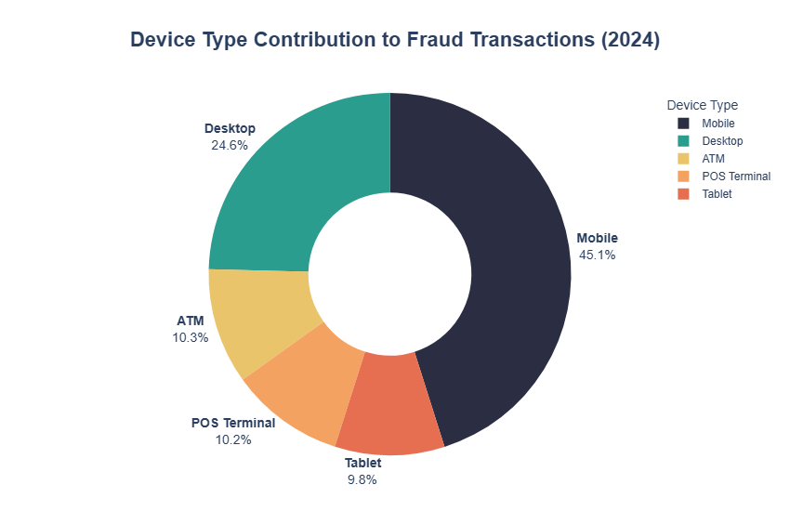
FRAUD CONCENTRATION (2024)
Device-Level Fraud Distribution
KEY INSIGHTS
Mobile devices recorded the highest number of fraudulent transactions in 2024, with 4,940 cases, accounting for 45.1% of all fraud, followed by Desktop devices with 2,690 cases (24.6%).
However, fraud rates across different device types were relatively similar, ranging from approximately 5.34% to 5.62%.
NOTE
High fraud volume on a device reflects high usage, not necessarily higher inherent risk.
Total Fraud Transaction :- 10949
Recommendation: Prioritize fraud monitoring for Mobile devices because of their high number of fraud cases. However, do not classify Mobile as the highest-risk device based on fraud count alone. Use device-specific fraud rates and customer behavior patterns before introducing stronger fraud controls.
Financial Fraud Analysis
8
Notes:
Same pattern with devices. Mobile drives the most fraud cases by far — 45% of all fraud — but that's because mobile is how most people transact today. Fraud rates across devices were actually quite similar, all in the 5.3 to 5.6 percent range. So again: high volume, not necessarily high risk.

Slide 9
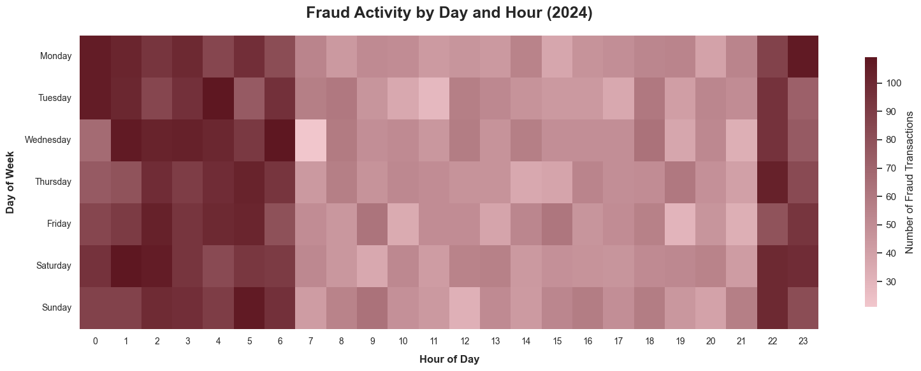
BEHAVIORAL PATTERNS (2024)
Fraud Timing Patterns
KEY INSIGHTS
Fraud activity is not evenly distributed throughout the day. Late-night and early-morning hours, roughly from 22:00 to 06:00, often show higher fraud counts than many daytime hours.
This pattern appears across most days of the week, suggesting a recurring fraud pattern rather than an isolated event.
NOTE
Compare fraud rates rather than raw counts by hour to account for normal variation in transaction volume throughout the day.
Recommendation: Consider stronger fraud monitoring and verification during the overnight hours when fraud activity is consistently high. However, check the fraud rate, not just the fraud count, before introducing stricter controls.
Financial Fraud Analysis
9
Notes:
Now, timing. This heatmap shows fraud is not spread evenly across the day — it clusters late at night and early morning, roughly 10pm to 6am. That's a consistent pattern worth building into monitoring rules, though I'd want to confirm it holds up as a rate, not just a count, before hardening any thresholds.

Slide 10
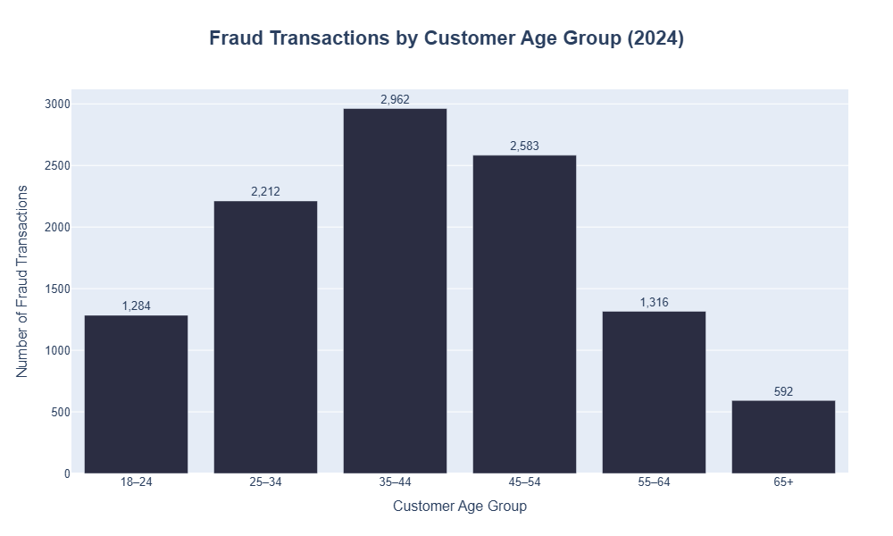
BEHAVIORAL PATTERNS (2024)
Customer Age Distribution
KEY INSIGHTS
Among fraudulent transactions in 2024, the 35–44 age group recorded the highest fraud count, with 2,962 cases, followed by the 45–54 age group with 2,583 cases and the 25–34 age group with 2,212 cases.
Together, the three middle age groups (25–54) accounted for the majority of fraud cases in the dataset.
NOTE
This is fraud-volume distribution, not proof that the 35–44 group is most vulnerable — fraud rate within each age group was not isolated here.
Recommendation: Use these findings as a starting point for prioritizing fraud investigations, not as a final conclusion about risk. Calculate the fraud rate for each age group before introducing any age-specific fraud controls.
Financial Fraud Analysis
10
Notes:
On demographics, the 35-44 age group has the most fraud cases, followed by 45-54 and 25-34. Important caveat: this is a count, not a rate — I don't know if that age group actually has a higher probability of fraud, just more cases, possibly because they transact more.

Slide 11
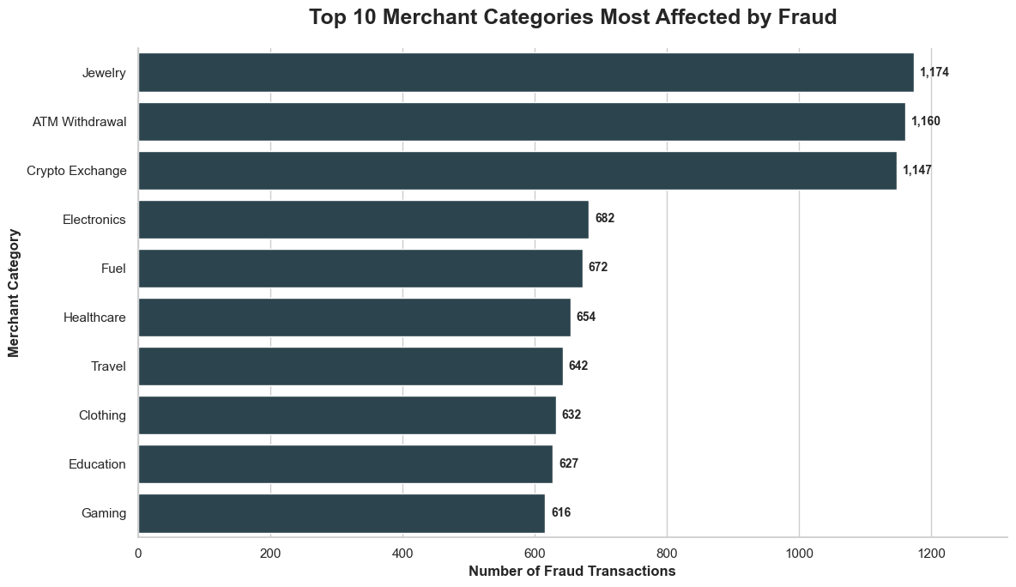
MERCHANT CATEGORY RISK (2024)
Not All Merchant Categories Are Equal
Verified Fraud Rates
Jewelry
8.86%
ATM Withdrawal
8.79%
Crypto Exchange
8.71%
For comparison, everyday categories sit far lower: Electronics (5.04%), Fuel (4.96%), and Healthcare (4.95%) — close to the dataset-wide average.
Chart shows fraud COUNT by category, not fraud rate — see verified rates at right.
Recommendation: Apply enhanced, risk-based monitoring and verification to these high-exposure categories rather than uniform controls.
Financial Fraud Analysis
11
Notes:
This is where things get more interesting — merchant category. This chart shows fraud COUNT by category, so Jewelry, ATM Withdrawal, and Crypto Exchange top the list. But I went further and calculated the actual fraud RATE for each category: Jewelry at 8.86%, ATM Withdrawal at 8.79%, Crypto Exchange at 8.71% — meaningfully higher than everyday categories like Electronics or Fuel. This tells us uniform fraud controls miss these high-exposure categories, and they deserve enhanced monitoring.

Slide 12
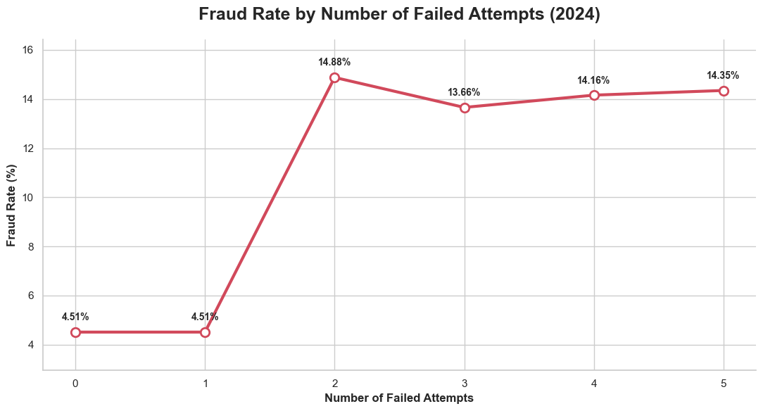
STRONGEST OBSERVED RISK SIGNAL
Failed Attempts and Fraud Rate
0–1 failed attempts
4.51%
2 failed attempts
14.88%
3–5 failed attempts
13.7%–14.4%
Fraud rate jumps sharply once failed attempts reach two or more. This is a strong observed association, not proven causation — treat repeated failed attempts as a high-priority signal for enhanced verification.
Financial Fraud Analysis
12
Notes:
This might be the single strongest signal in the whole analysis. When a transaction has zero or one failed attempts, the fraud rate is 4.51%. But at two or more failed attempts, it jumps to nearly 15% and stays there. That's roughly a threefold increase. I want to be careful not to claim causation, but this association is strong enough that two-or-more failed attempts should trigger extra verification in a real system.

Slide 13
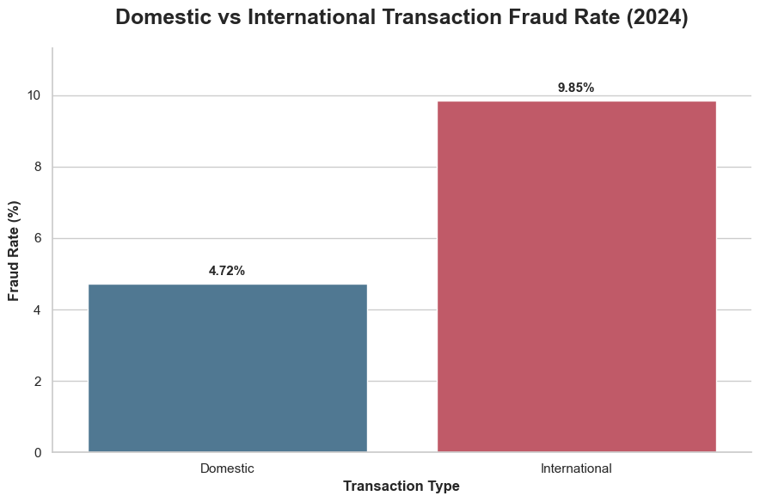
CROSS-BORDER EXPOSURE (2024)
International Transaction Risk
Domestic
4.72%
International
9.85%
International transactions show more than twice the fraud rate of domestic transactions in this dataset.
Recommendation: Apply enhanced, risk-based authentication to unusual international transactions — combined with other signals — rather than blocking them automatically.
Financial Fraud Analysis
13
Notes:
International transactions show a fraud rate of 9.85%, more than double the domestic rate of 4.72%. My recommendation is NOT to block international transactions outright — that would hurt legitimate customers — but to apply smarter, risk-based authentication, especially combined with other red flags.

Slide 14
EXECUTIVE SUMMARY
Key Findings and Business Recommendations
Fraud is persistent
Annual fraud rates stayed near 5.5% from 2020–2024.
Treat fraud controls as an ongoing operational priority, not a one-time fix.
Merchant category matters
Jewelry, ATM Withdrawal, and Crypto Exchange exceeded 8.7% fraud rates.
Apply enhanced, risk-based monitoring to these high-exposure categories.
Failed attempts are a strong signal
Fraud rate jumped from 4.51% to ~14% at two or more failed attempts.
Flag repeated failed attempts for additional verification.
International transactions carry more risk
9.85% fraud rate vs. 4.72% domestic.
Use enhanced authentication for unusual international activity.
Volume ≠ risk
High fraud volume (Mobile, Credit Card, USA) doesn't mean highest fraud rate.
Always evaluate fraud rate, not just count, before targeting controls.
Financial Fraud Analysis
14
Notes:
Let me bring it all together. Five key findings: fraud is persistent at around 5.5%; certain merchant categories carry real elevated risk; two-plus failed attempts is a strong warning sign; international transactions carry meaningfully more risk; and — the theme running through everything — high fraud volume doesn't automatically mean high fraud risk. Each finding pairs with a specific, practical recommendation.

Slide 15
Thank You
Questions & Discussion
Financial Fraud Analysis
Notes:
To close: fraud risk here is multi-dimensional. No single transaction feature tells the whole story on its own. The strongest path forward is combining signals — failed attempts, international status, and merchant category together — as part of a layered, risk-based monitoring strategy. Thank you — happy to take questions.

